Slide 1
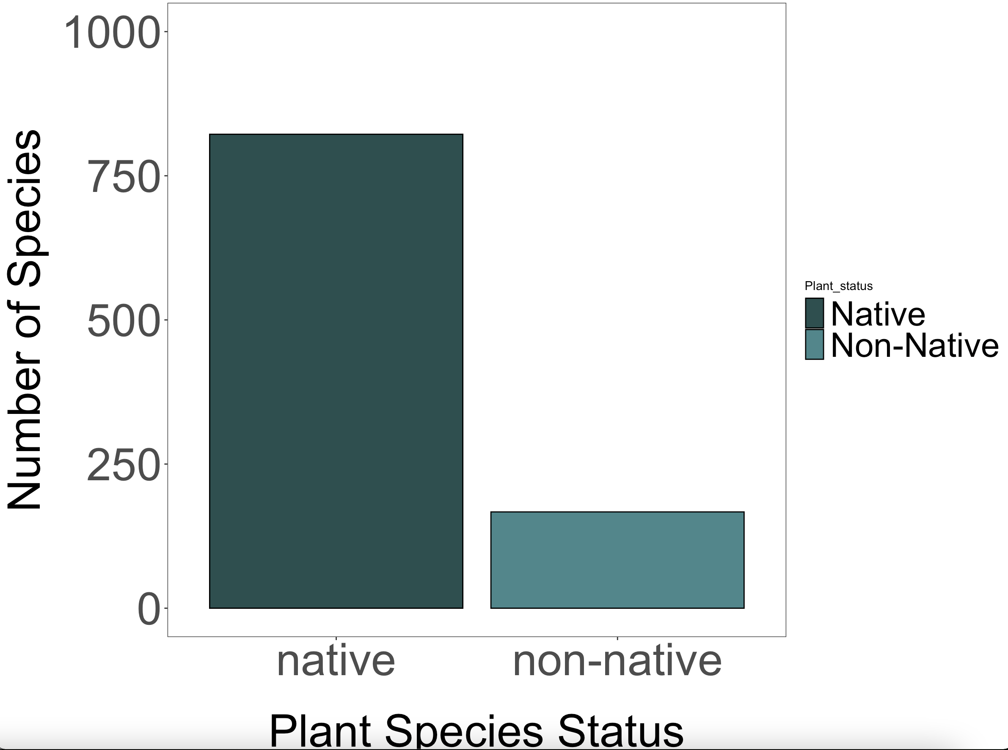
Number of legume species that are native vs non-native in the range they’re found

Slide 2
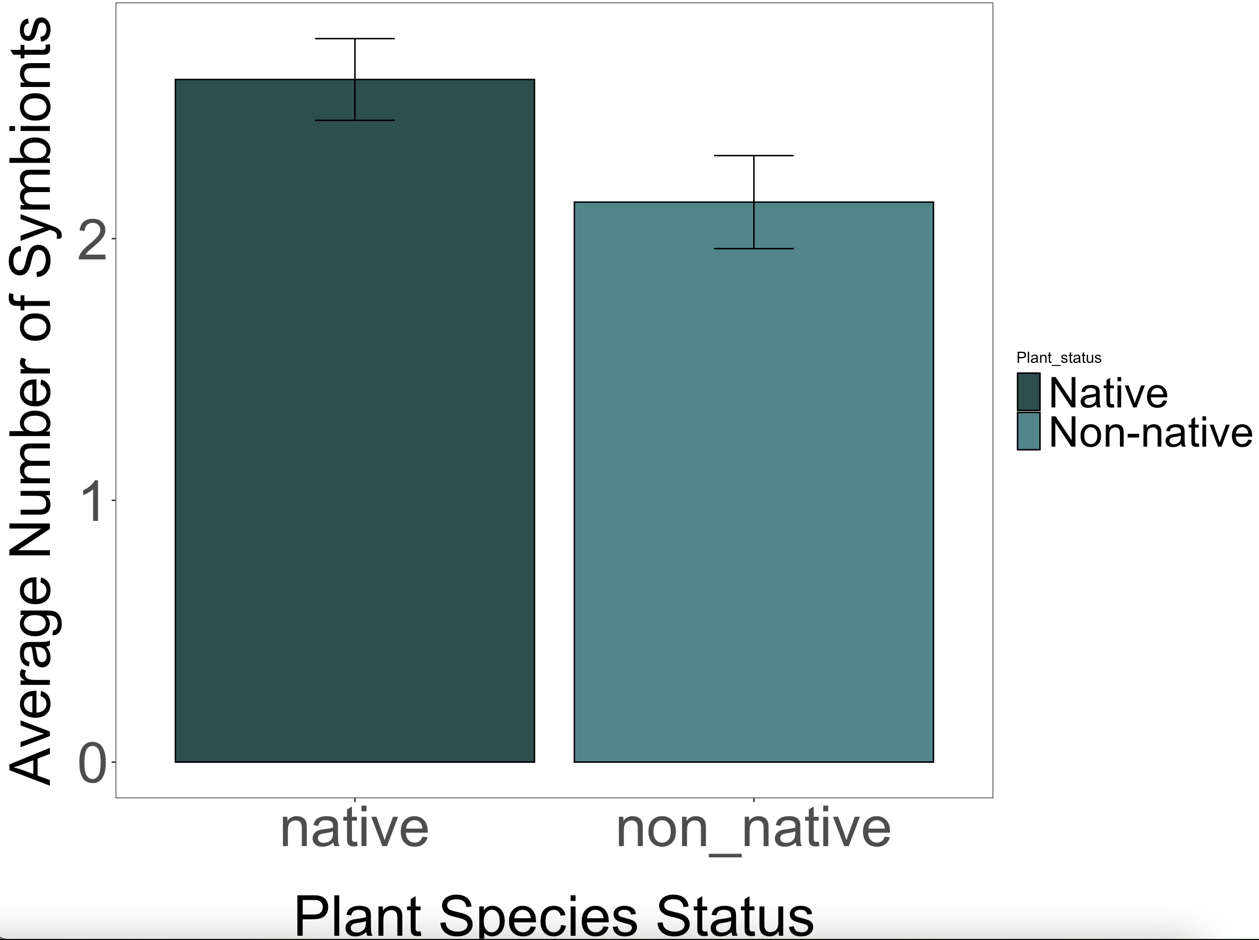
Average number of symbionts for native and non-native plant species

Slide 3
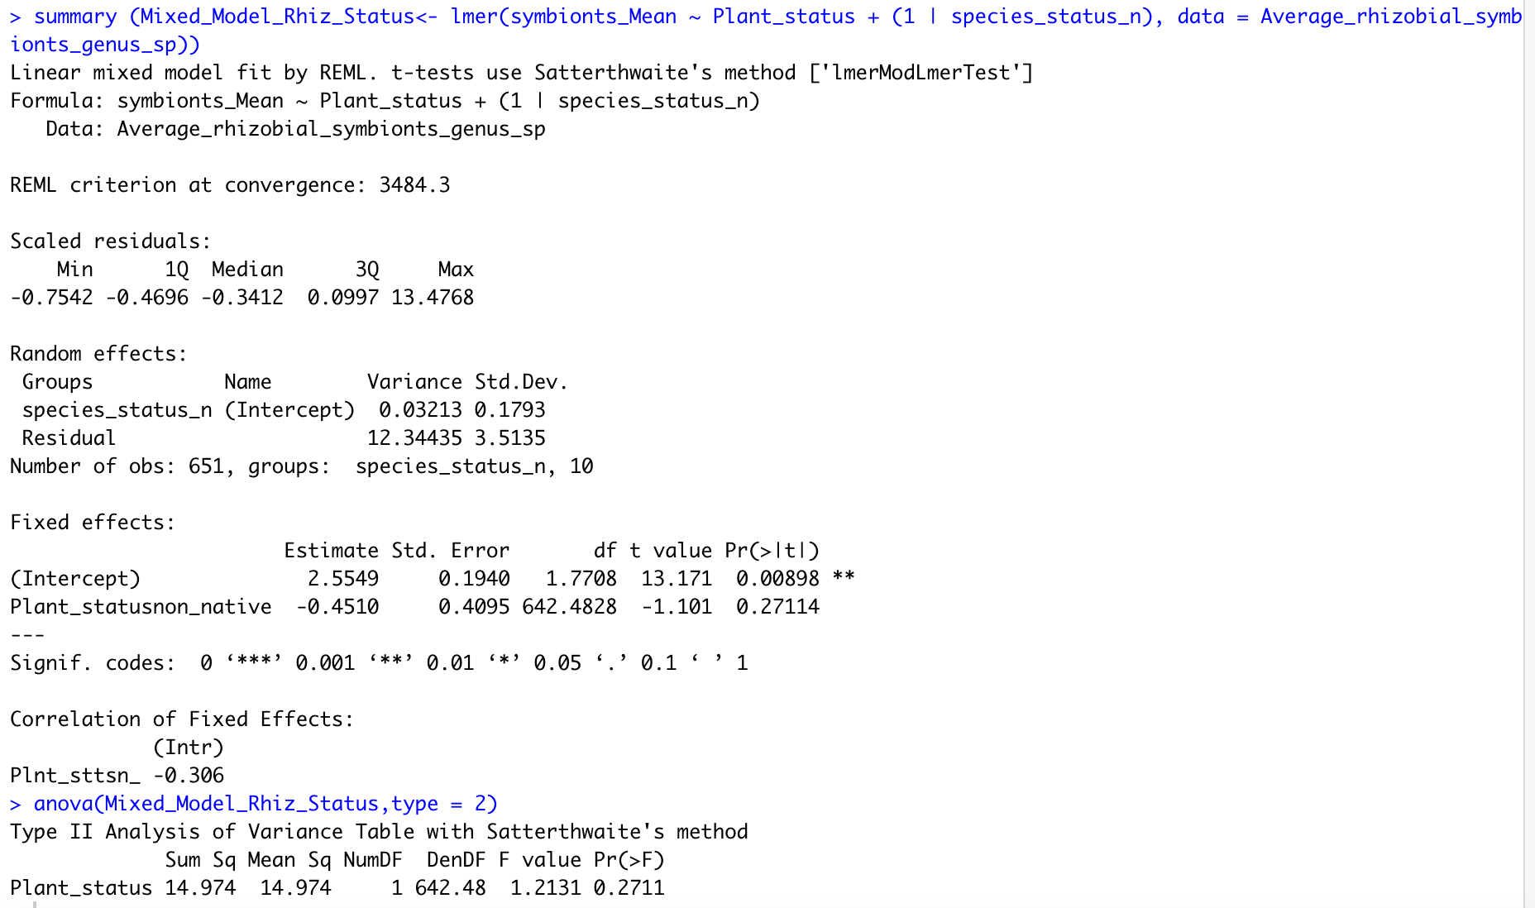
Mixed model of average symbionts by plant status

Slide 4
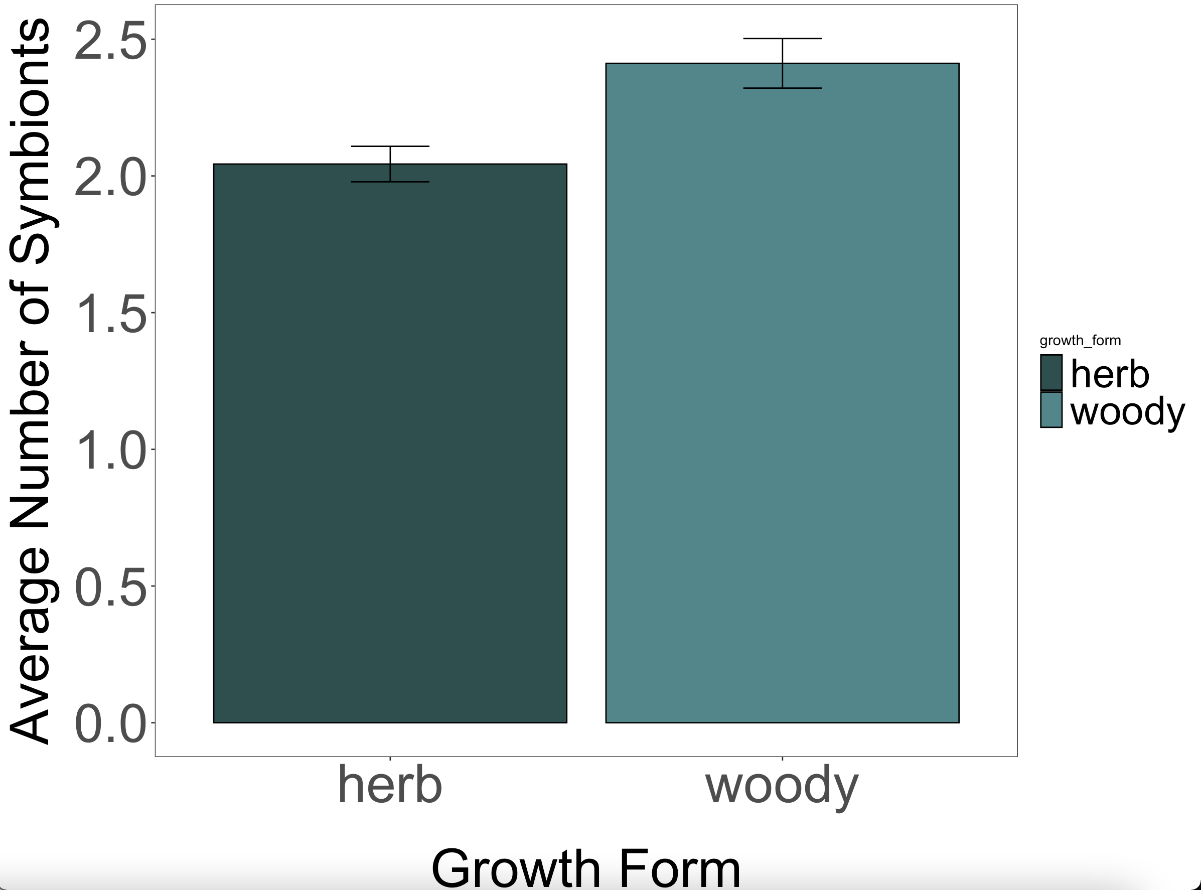
Average number of symbionts by growth form

Slide 5
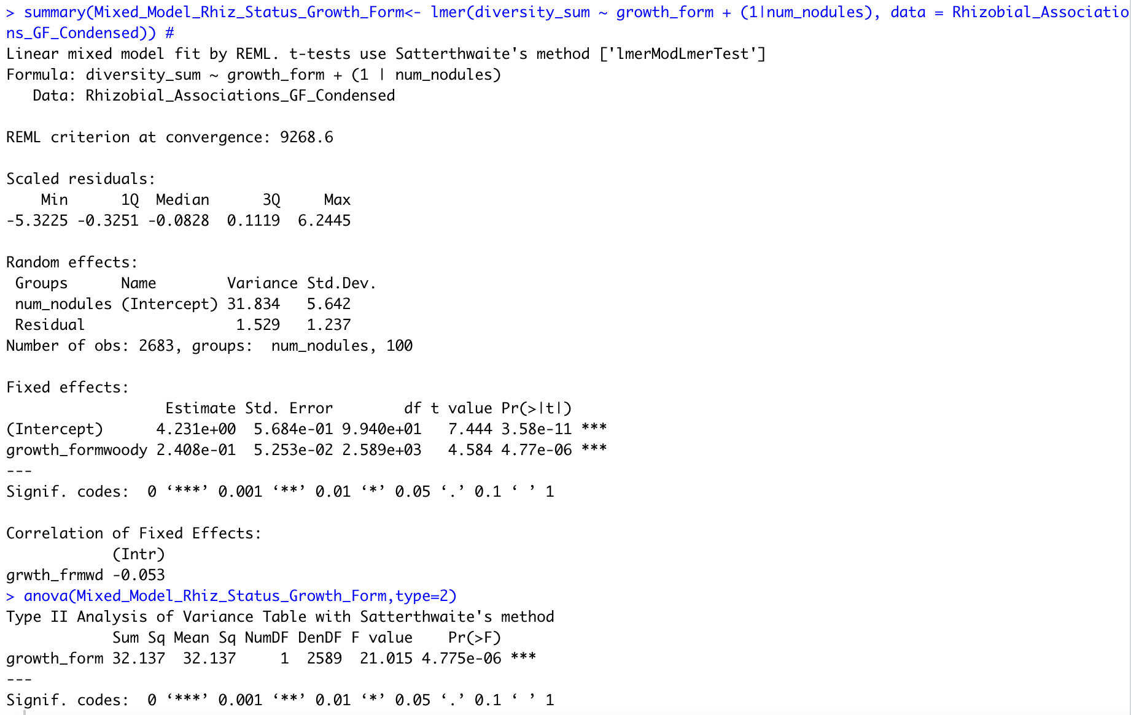
Average number of symbionts by growth form

Slide 6
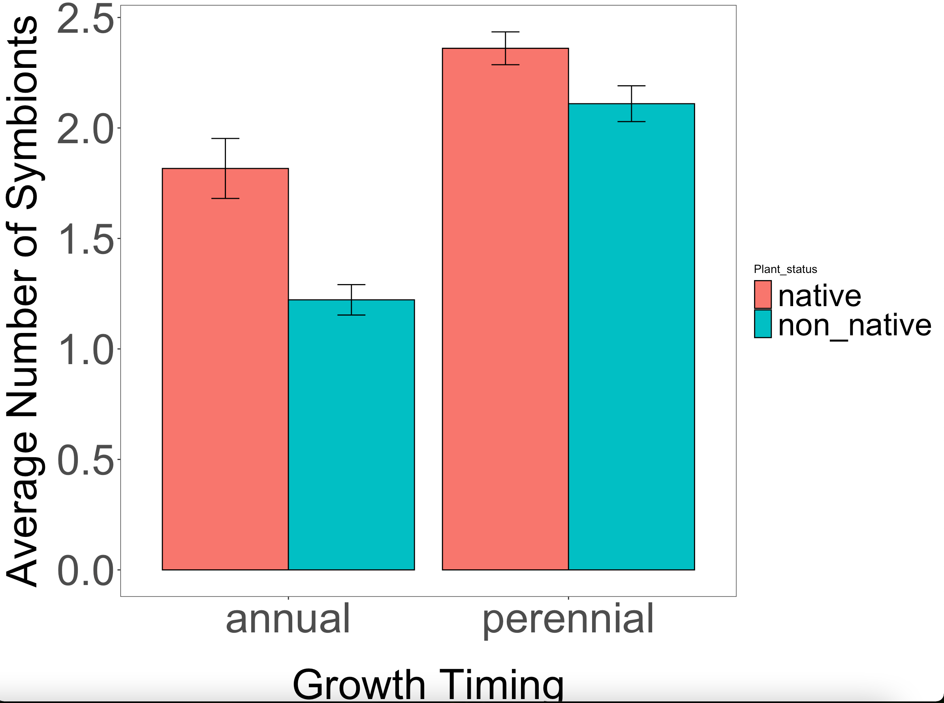
Average number of symbionts by status and growth timing

Slide 7
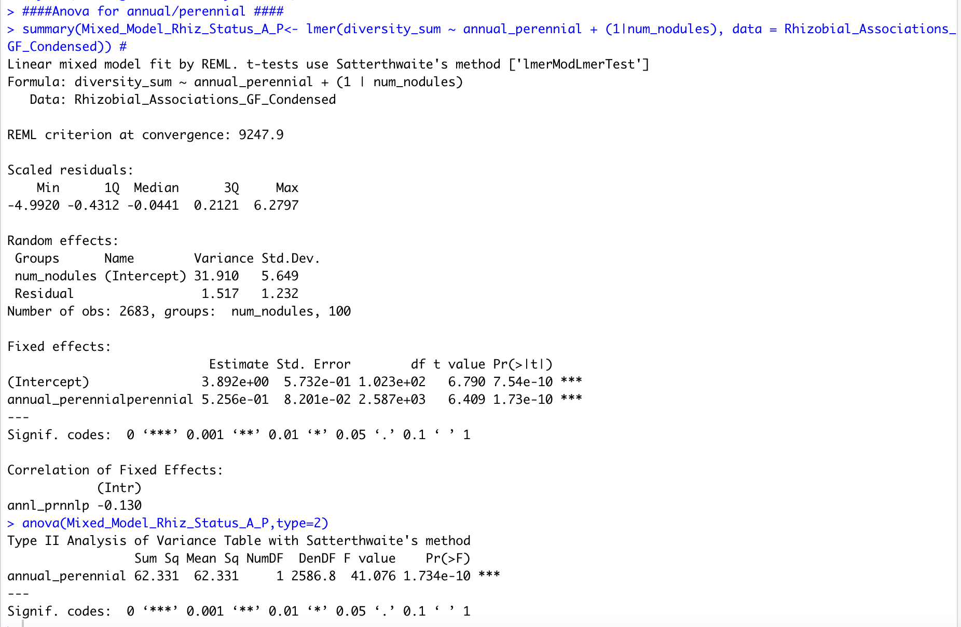
Average number of symbionts by annual/perennial

Slide 8
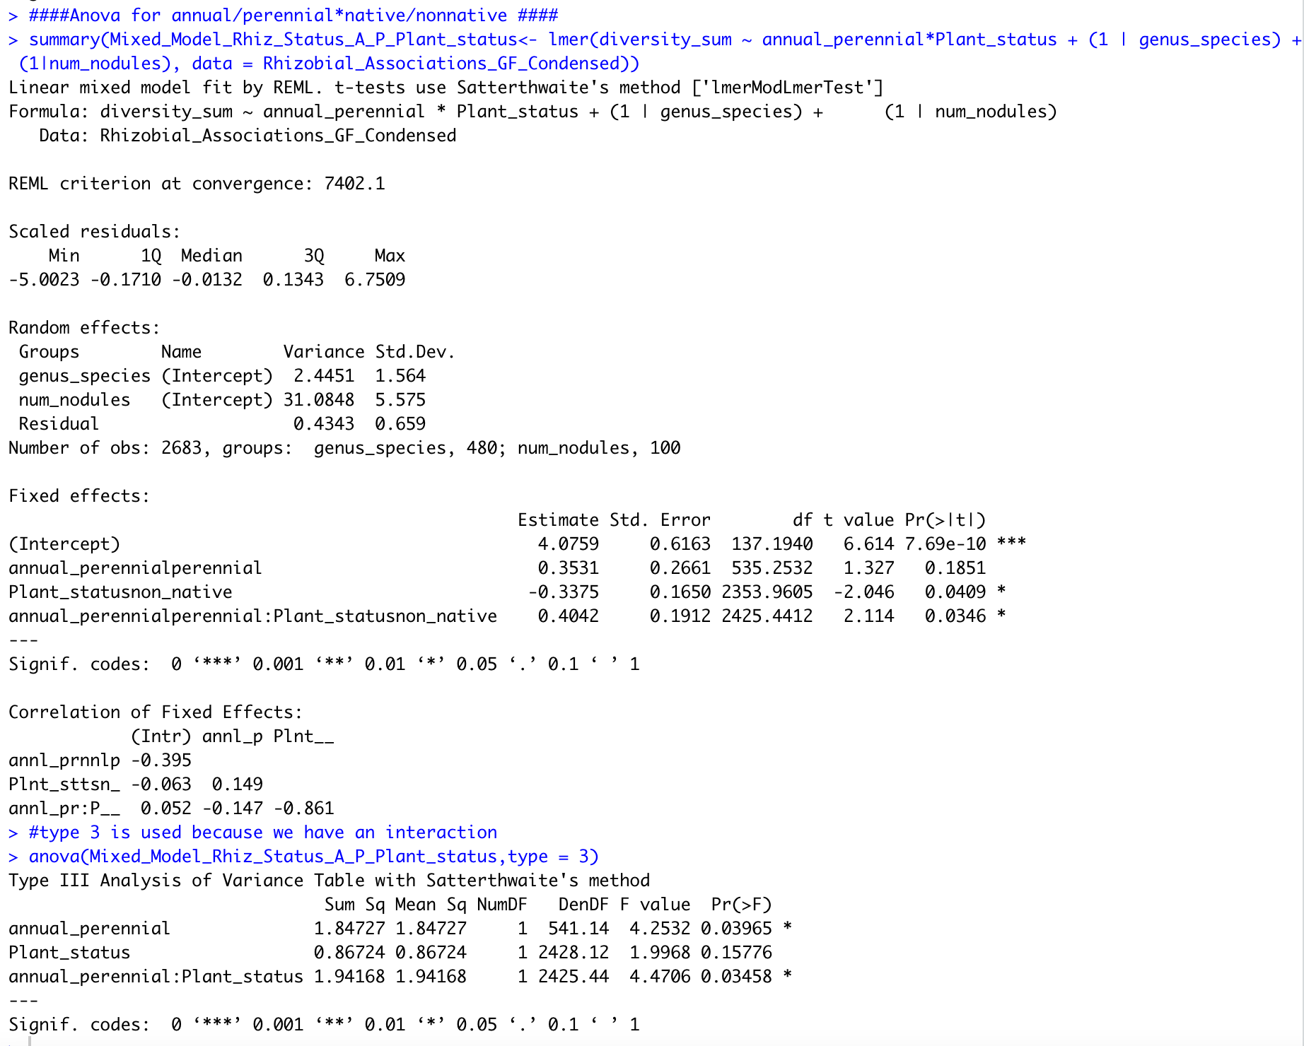
Average number of symbionts by status and growth timing

Slide 9
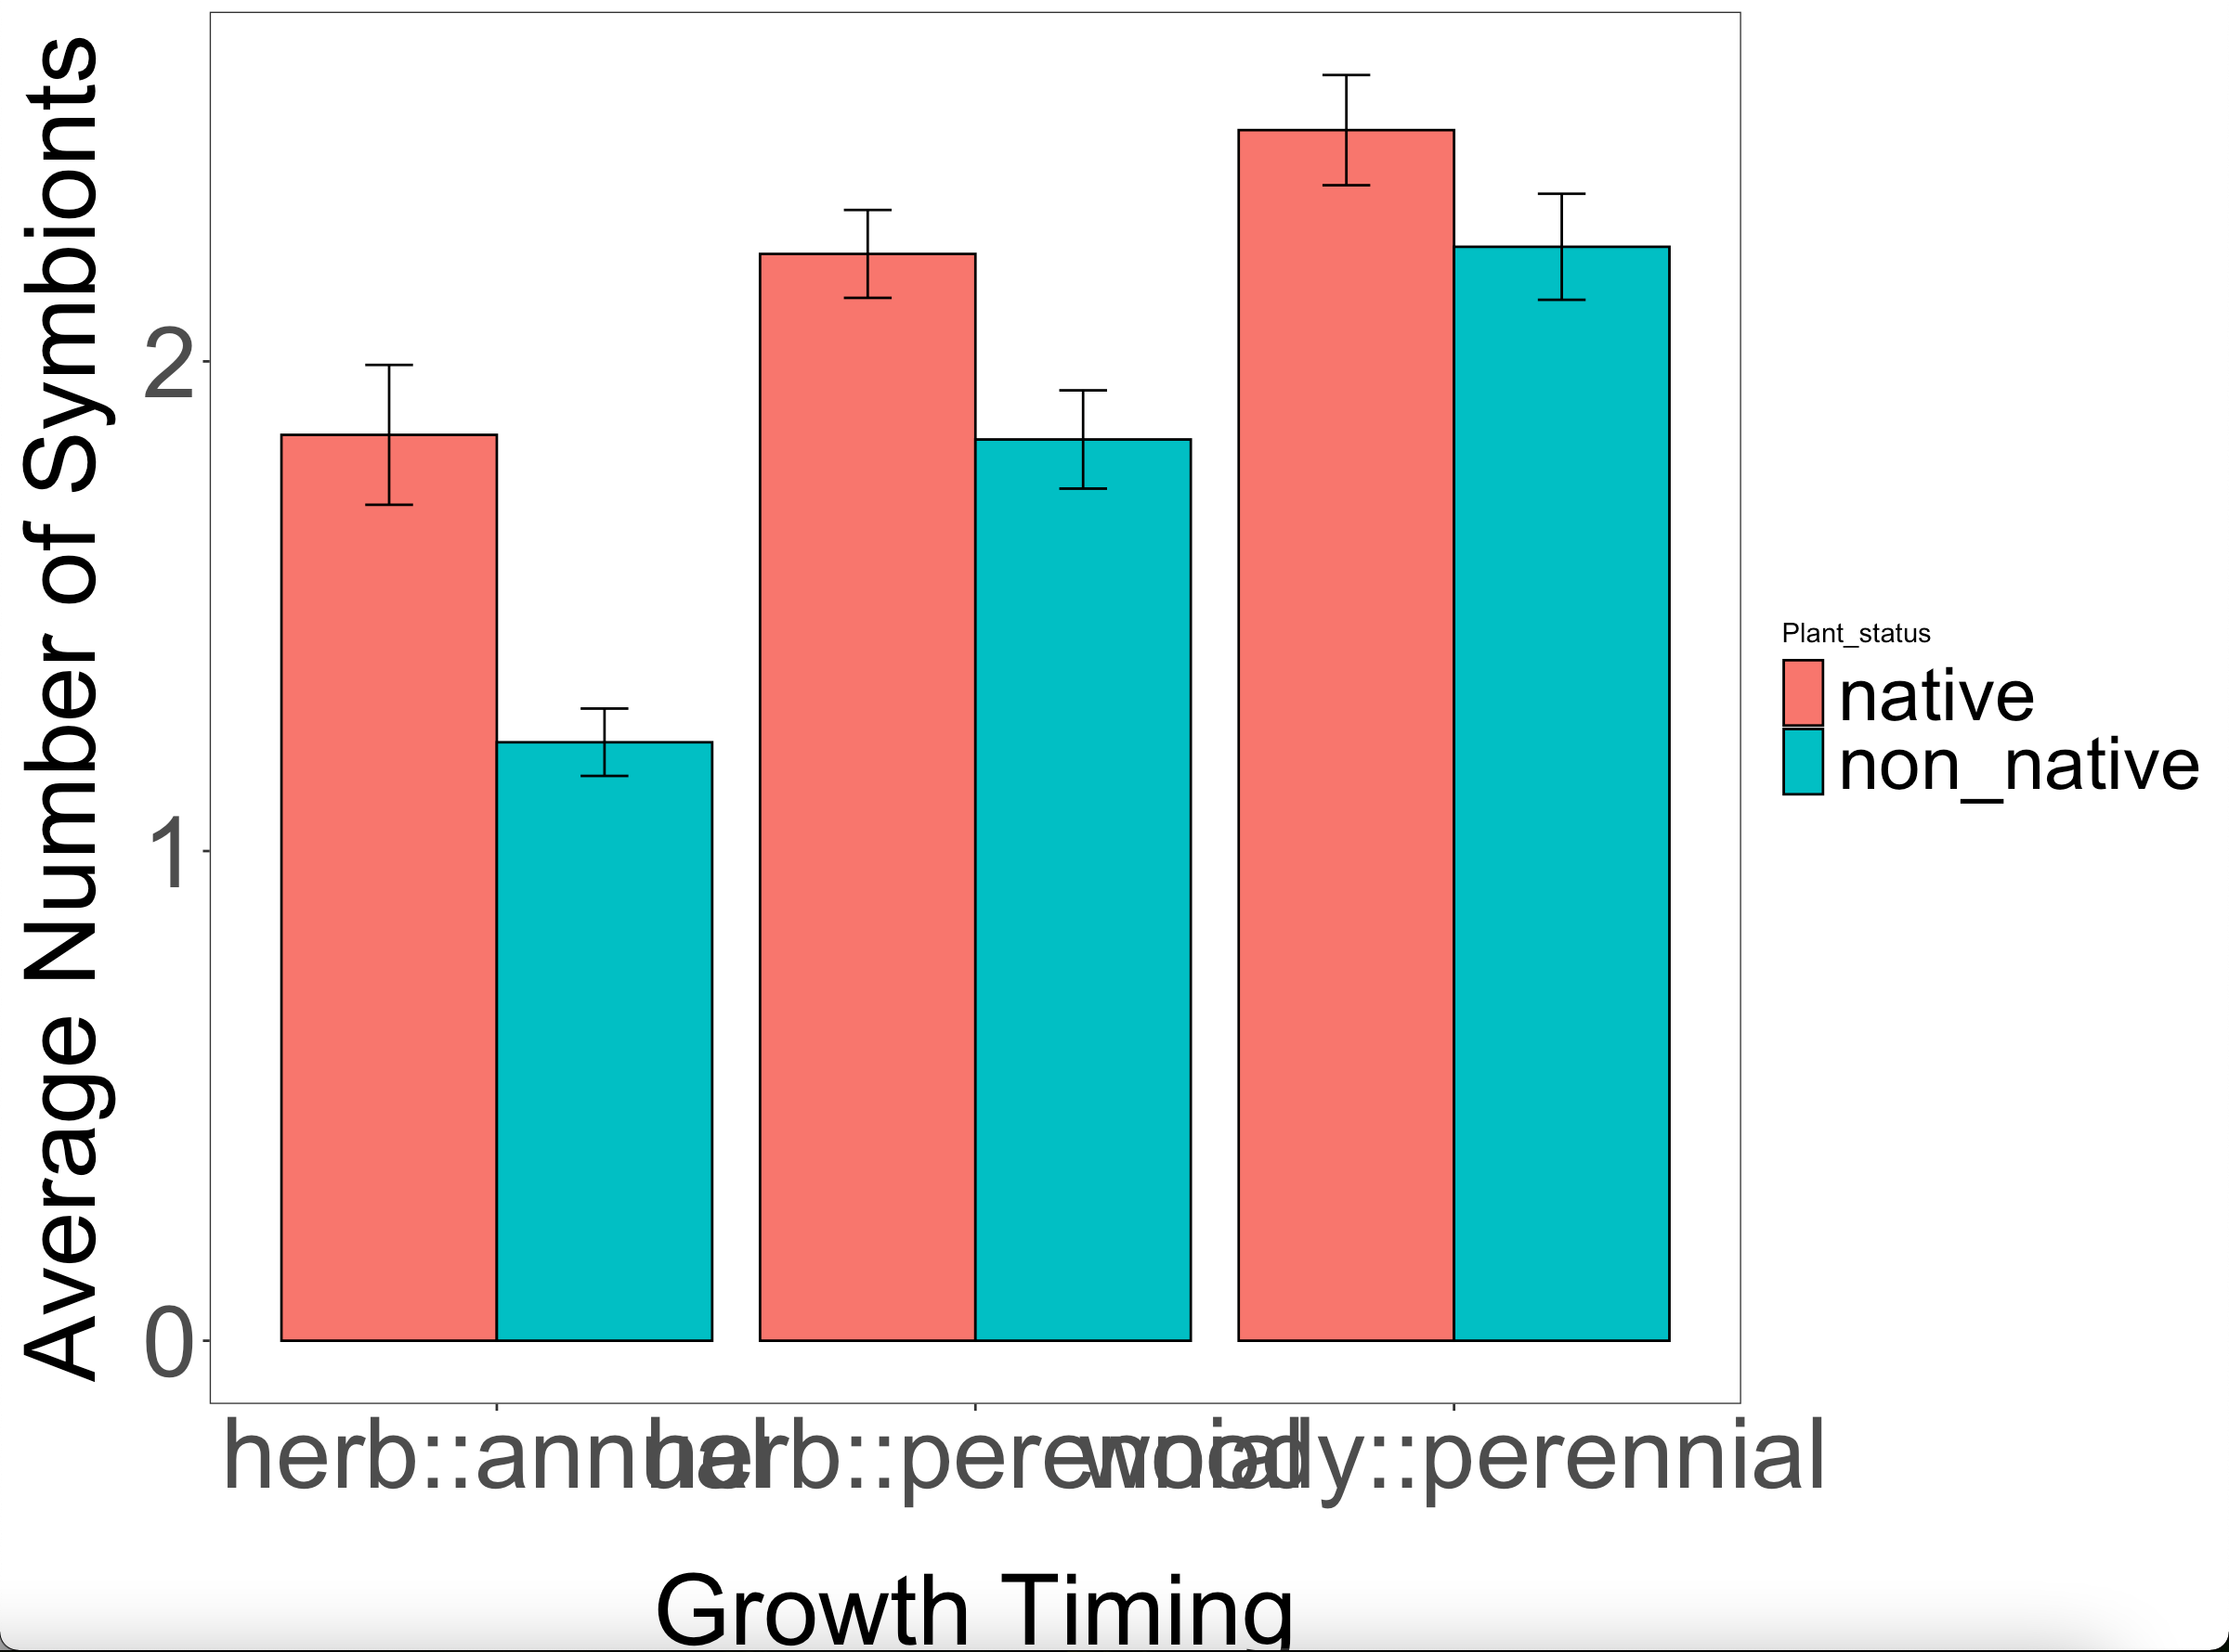
Average number of symbionts by status and growth timing:growth form

Slide 10
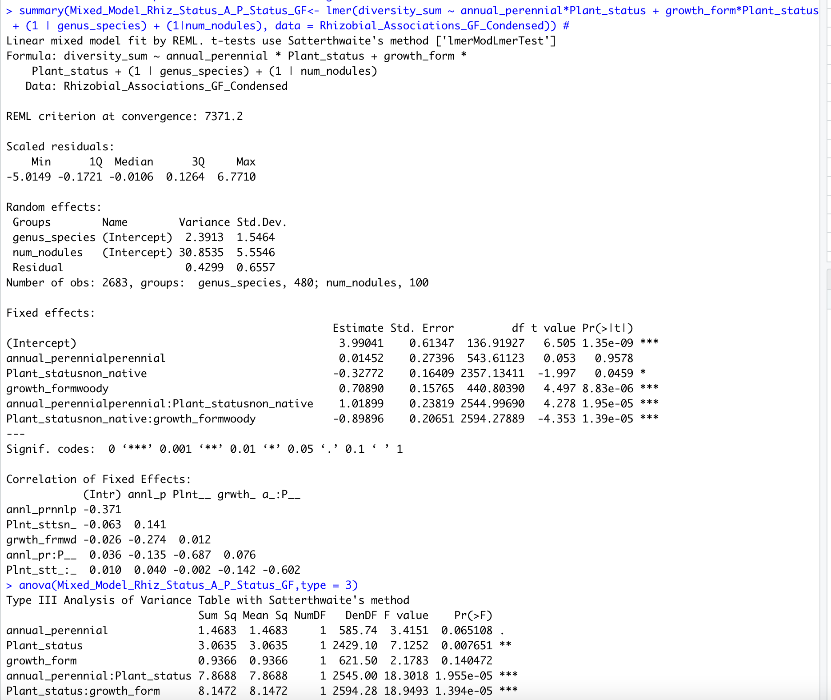
Average number of symbionts by status and growth timing and growth form

Slide 11
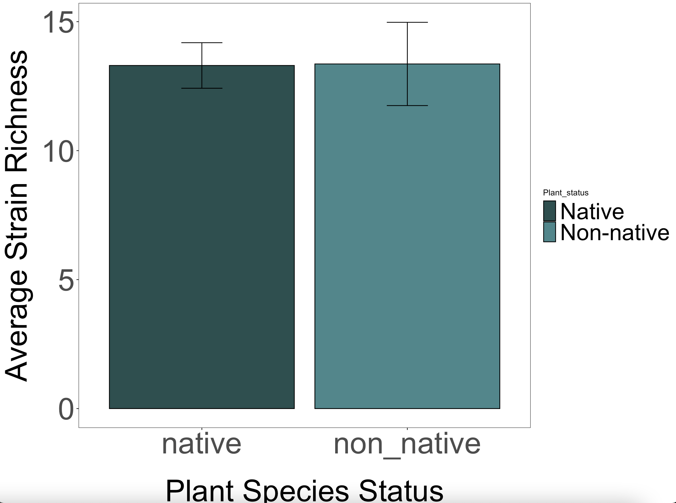
Average strain richness by plant status

Slide 12
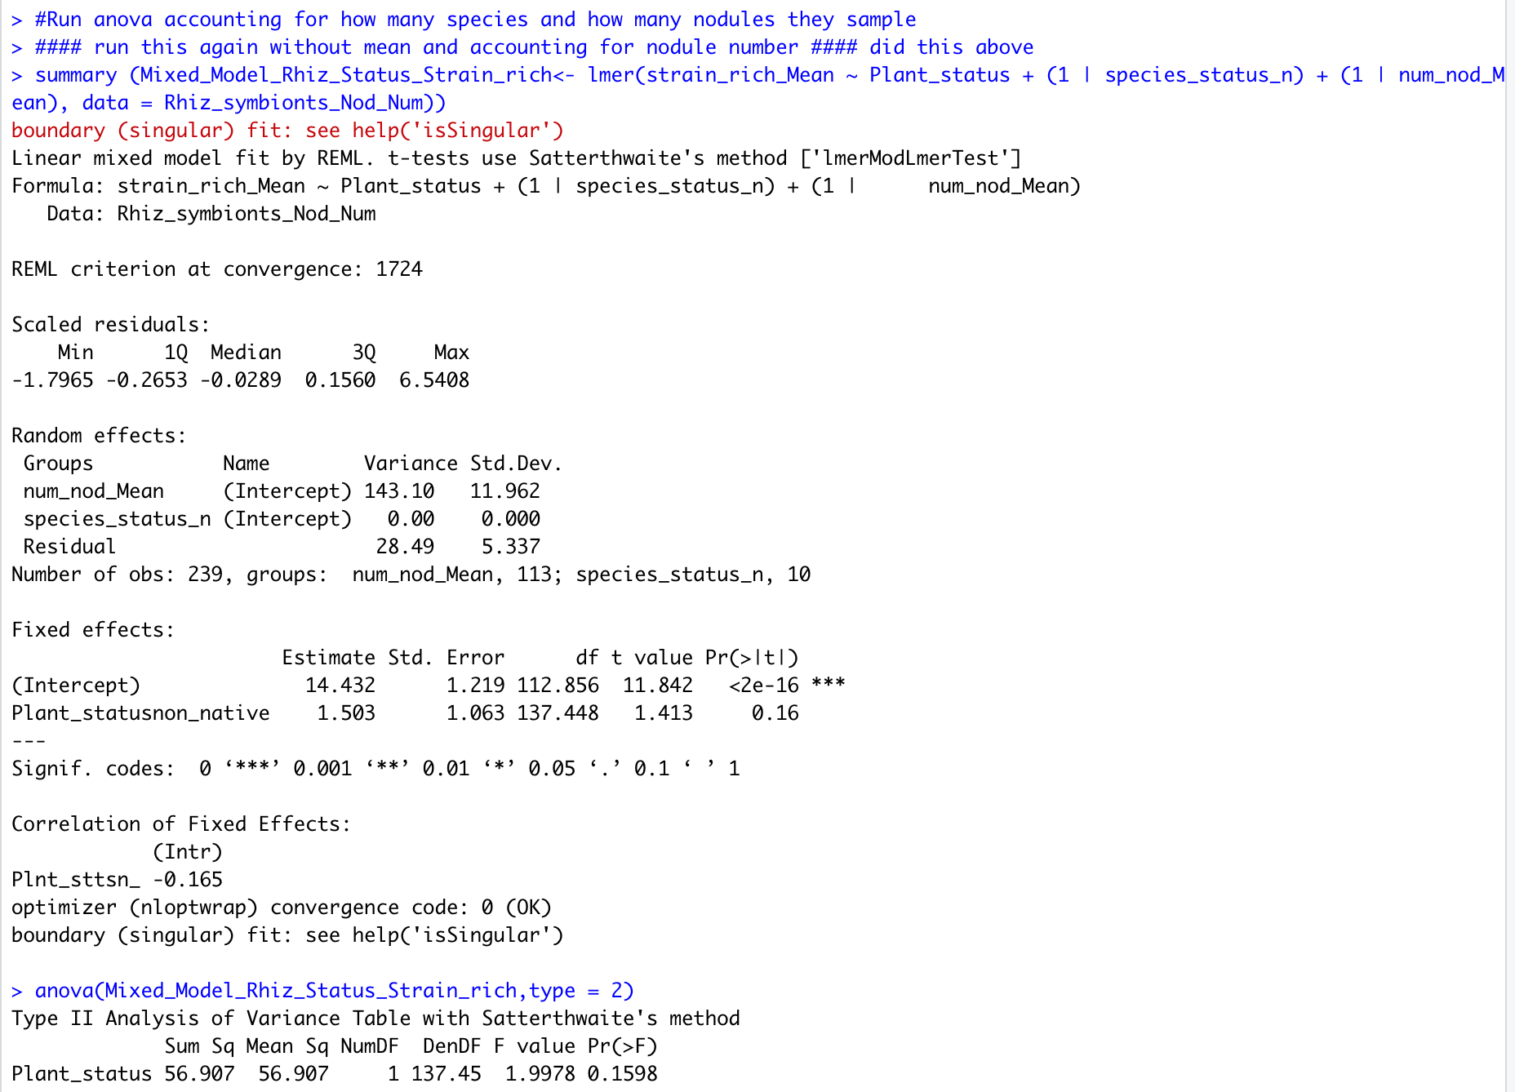
Average strain richness by plant status

Slide 13
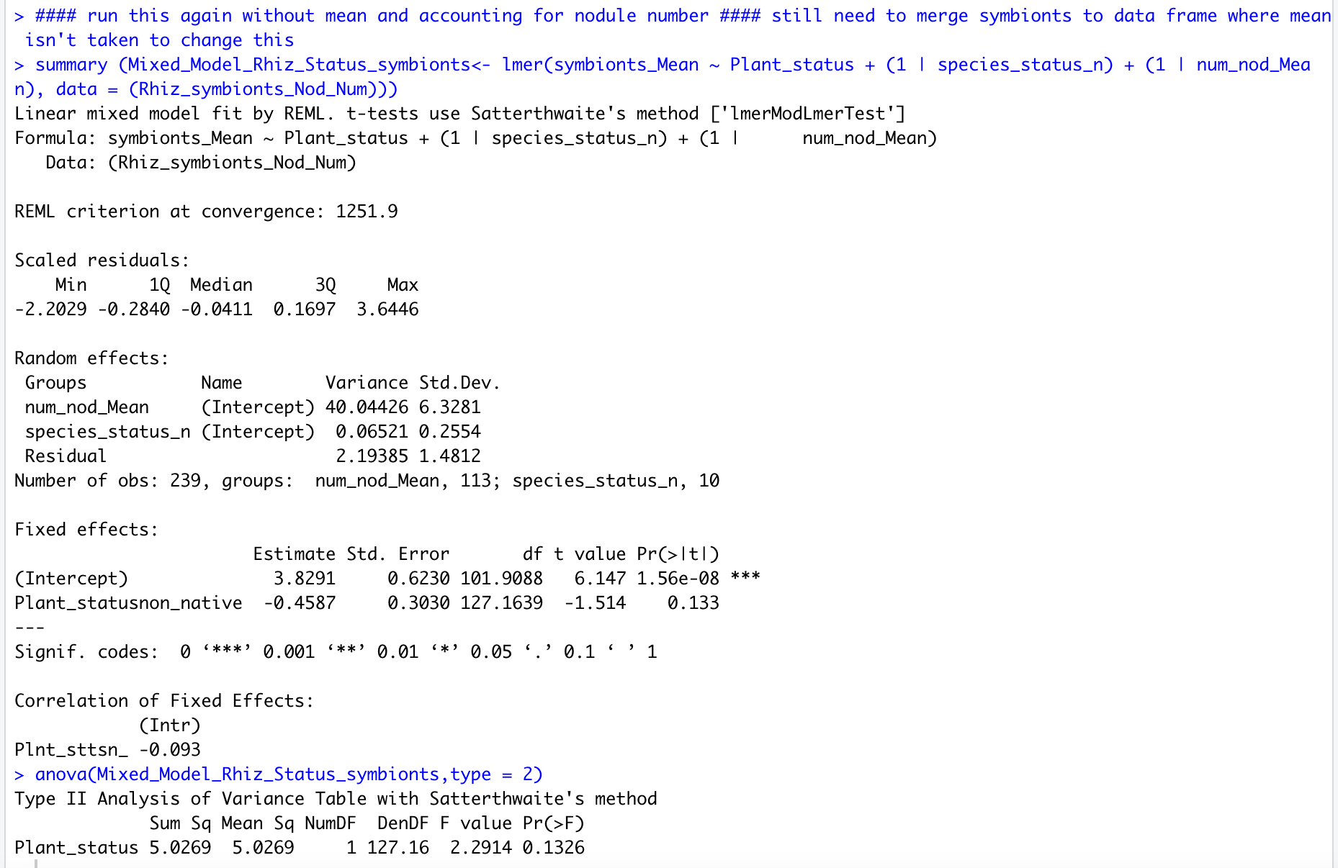
Average symbiont by plant status

Slide 14
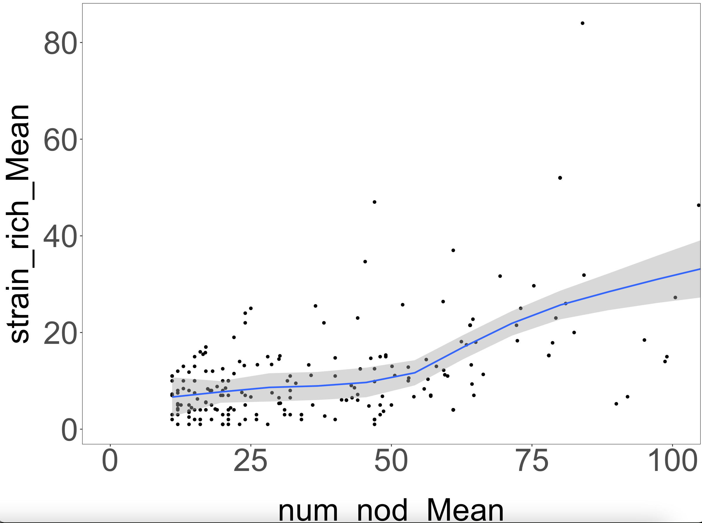
Mean nodule number by mean strain richness (as you have more nodules do you have higher richness?)

Slide 15
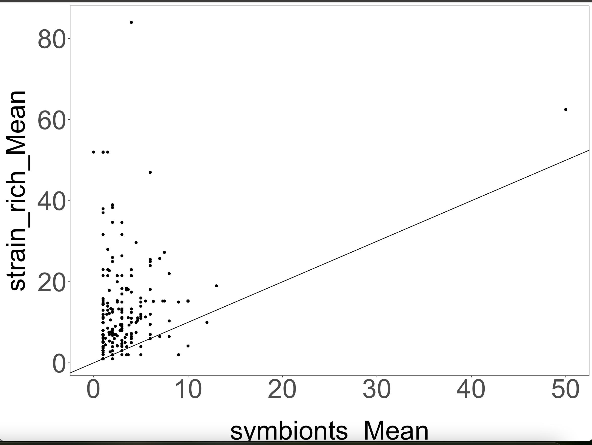
Mean symbionts by mean strain richness

